Slide 1
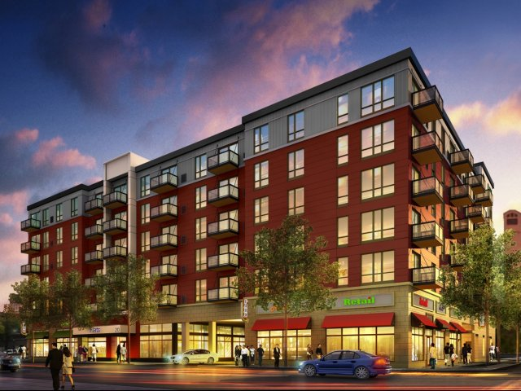

How to Prepare for Rental Inspections

Slide 2


Goals
City of Duluth Rental License Requirements
Overview of the Codes
  History
  Regulations/Which Codes
Inspection Process
Common Code Corrections
Best Practices

Slide 3

Duluth Fire Department
Life Safety Division
Number of rental licenses
  Over 17,500 Units
  Over 15,000 Licenses
  40% of residences are rentals
Staff
  Lead Housing Inspector
  5-Housing Inspectors
  Solid Waste Compliance Officer
  Police Officer
  2-Office Staff
  Blight Mitigation Specialist

Slide 4
License Fees-New Licenses
One Family Dwelling
Two Family Dwelling (Duplex)
  Rental License Base Fee: $320.
  $40 Fee Per Bedroom:
  Conversion Fee: $1500.
  Off-Street Parking Required
    Must install O.S.P.
    $100.00 fee per required space if not provided.
  No Conversion Fee
  Rental License Fee: $320.
  $40 Fee Per Bedroom
  Off-Street Parking Required
    Must install O.S.P.
    $100.00 fee per required space if not provided.

Slide 5
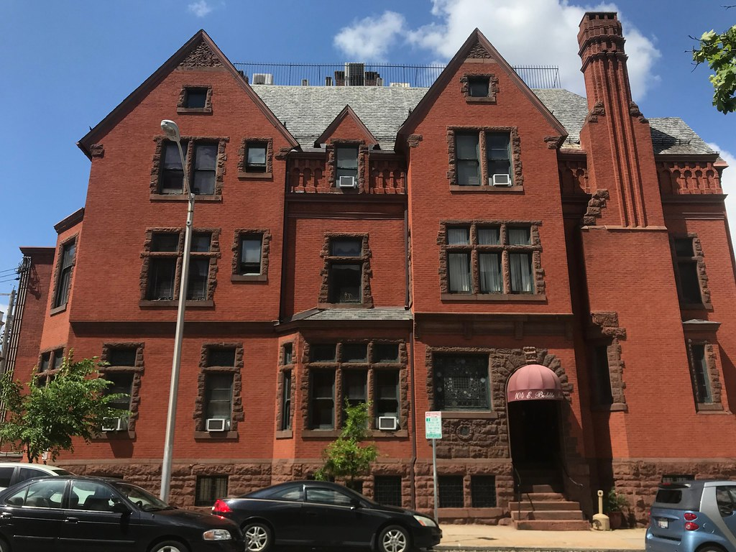
3+ units (multi dwellings)
$320 Base fee
$40 per unit
No parking requirements

Slide 6

Rental License
Allows owner to rent to anyone for 30 days or more
3-Year License Cycle
  Inspection
License renewal sent out 3 months prior to expiration

Slide 7

Bedrooms
Existing: Maximum 6 bedrooms per unit.
New: After August, 2017 bedrooms are capped at 4 per unit for new rental properties if adequate off-street parking is available. Up to 5 bedrooms are allowed if the property is recorded with the Assessor as having a minimum of 2500 sq.ft. of finished space as of August, 2017

Slide 8
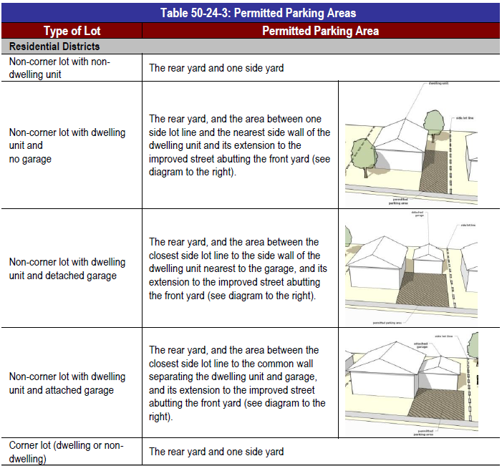
Parking Requirements
Off-Street Parking
(Single Family and Duplex)
Minimum of two off-street parking spaces required
After two spaces, one less than the bedroom count.
  3-bedrooms=2 O.S.P.
  4-bedrooms=3 O.S.P.

Slide 9
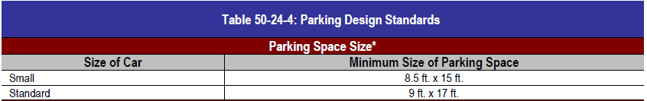
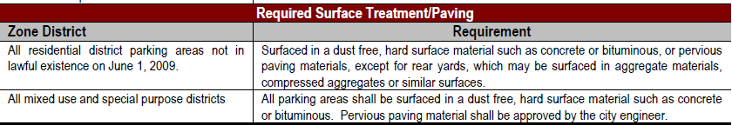
Parking Spaces

Slide 10
Code History and purpose
Purpose
  Codes were created based on property damage, injury or death
  Large devastating fire events
  Regulate and standardize construction/fire protection/maintenance
  Protect the health and safety of the public

Slide 11

Rental Inspection codes
International Property Maintenance Code
  Model Code
  Minimum Maintenance and Safety Code for Existing Buildings
  Light, Ventilation, Plumbing, Heating, Interior/Exterior, Fire, Sanitation, Electrical
  3-Year Modification Cycle

Slide 12
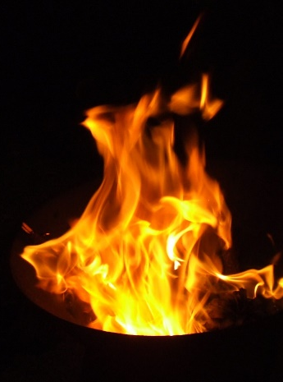
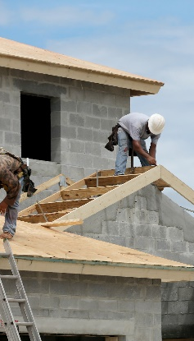
Other codes
Building Code/Existing Building Code
Minnesota State Fire Code
Other

Slide 13
Duties
Inspect all rental housing
Investigate Unlicensed Rental Properties
Investigate Complaints
Repairs
Lack of Heat
Condemn Properties
Lack of Utilities
Unsafe/Unsanitary Conditions
Fire Damage
Structural Damage
Investigate and Enforce Solid Waste Violations

Slide 14
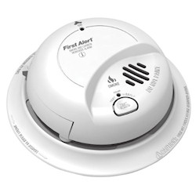

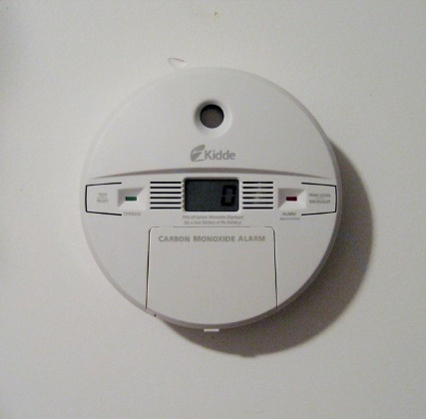
Preparing for Inspections
Notify Tenants
Proactive Visit
Check all Smoke and Carbon Monoxide Alarms
  Battery
  Expiration Date
If maintenance is required, have a plan, and share with inspector

Slide 15
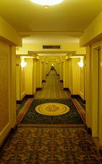
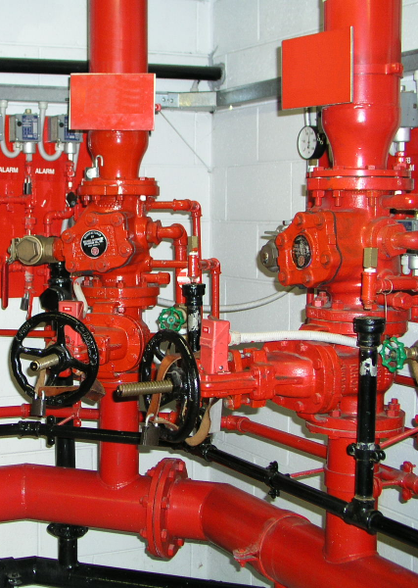
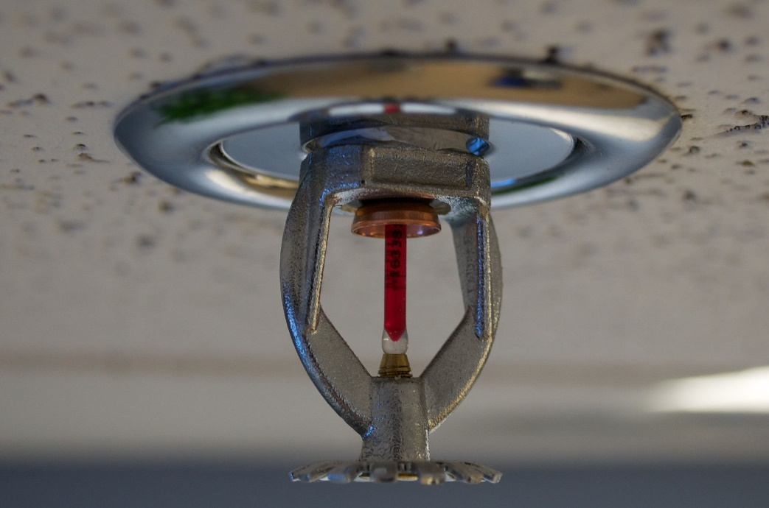
Preparing for md inspections
Clear all hallways, corridors, stairways
Have Sprinkler System, Fire Extinguishers and Fire Alarm Inspected

Slide 16

Common Code Requirements for Rental Licensing

Slide 17
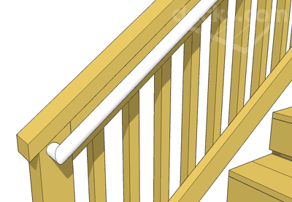
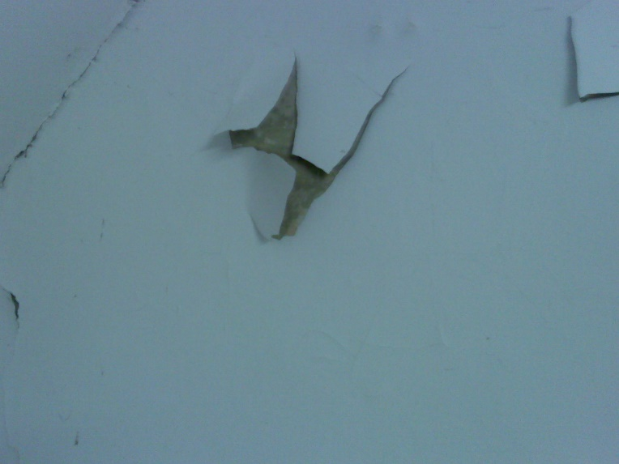
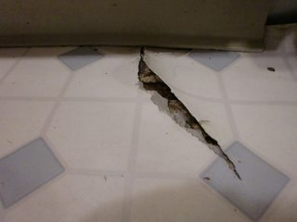
Interior
Peeling, chalking, flaking paint
Flooring-Free form tears, holes, etc.
Handrails and guards on stairs
  More than 4 risers
  Not less than 30” in height
  Guards required where walking surface is more than 30” to floor or grade below.

Slide 18

Windows
Cracked Glass
(may not be replaced with plexiglass)
Windows
Every window, other than a fixed window, shall be easily openable and capable of being held open by window hardware (as designed).

Slide 19
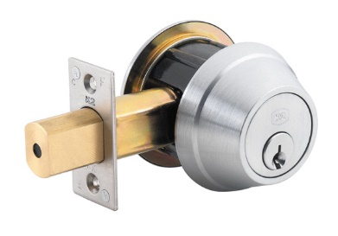
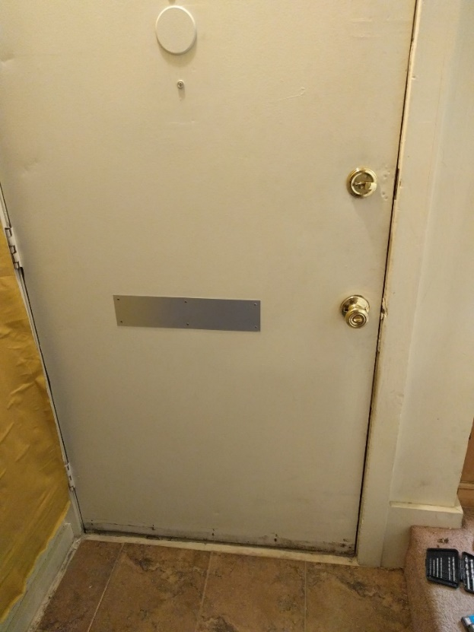
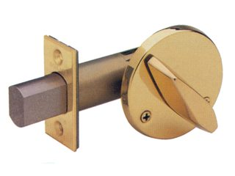
Doors
304.18.1 Doors – Deadbolt locks on rental, leased or sublet dwelling units.
  – Openable from side from which egress is to be made without the need for keys, special knowledge or effort.
    – Lock throw of not less than 1”.
    – Maintained in good working condition.
This Photo by Unknown Author is licensed under CC BY-SA
This Photo by Unknown Author is licensed under CC BY-SA

Slide 20
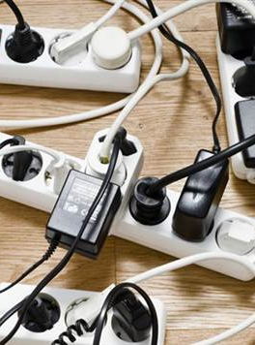
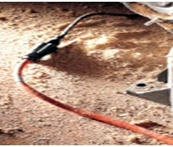
Extension cords
Cannot be used for permanent power
Cannot be daisy chained
May not be used for appliances, space heaters, etc
Power Strips with overload protection (20 AMP rated) allowed.

Slide 21
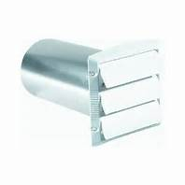
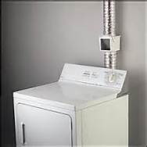
Dryer Venting
No Plastic Vent lines
4” in diameter with two 90 degree elbows terminating outside
Back draft damper
No lint traps, heat diverters, or screens

Slide 22
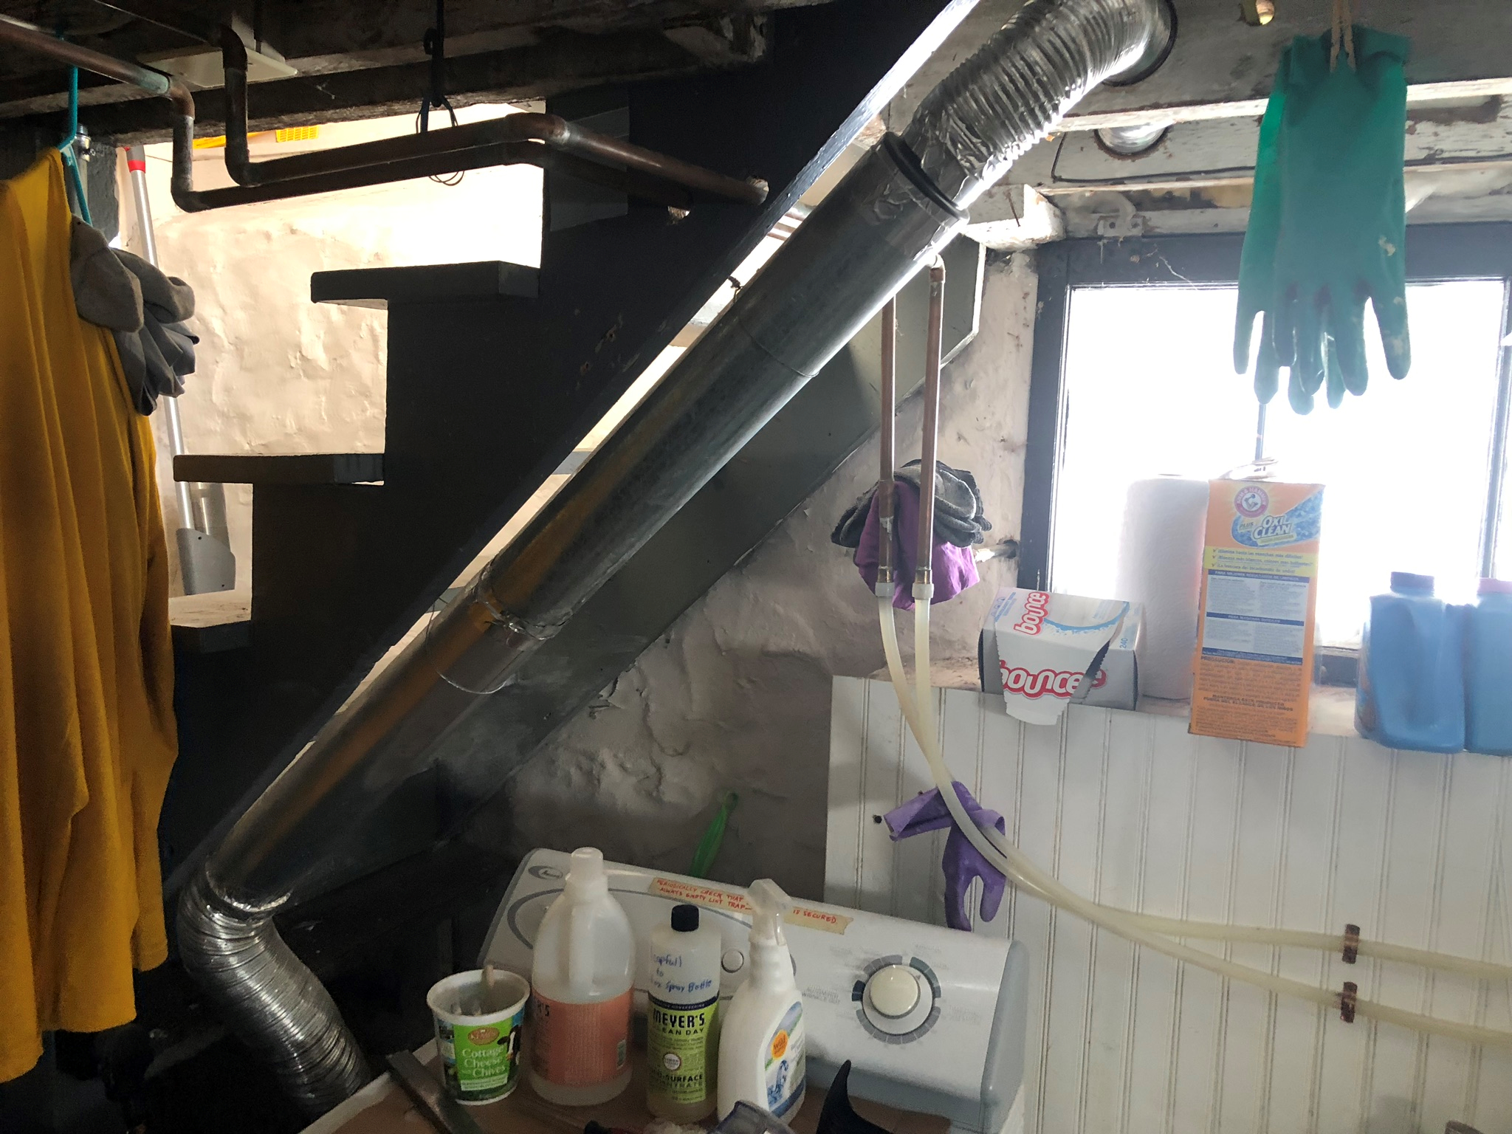

Slide 23
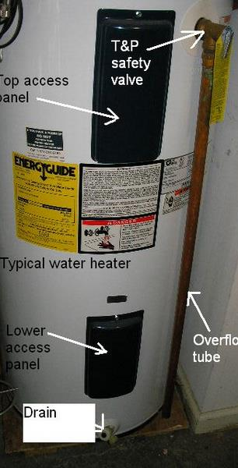
Water Heater
Connections maintained
Panels Intact
Overflow tube/pipe metal or copper and within 18” of the ground.
Smokepipe has positive slope to chimney or power vented

Slide 24
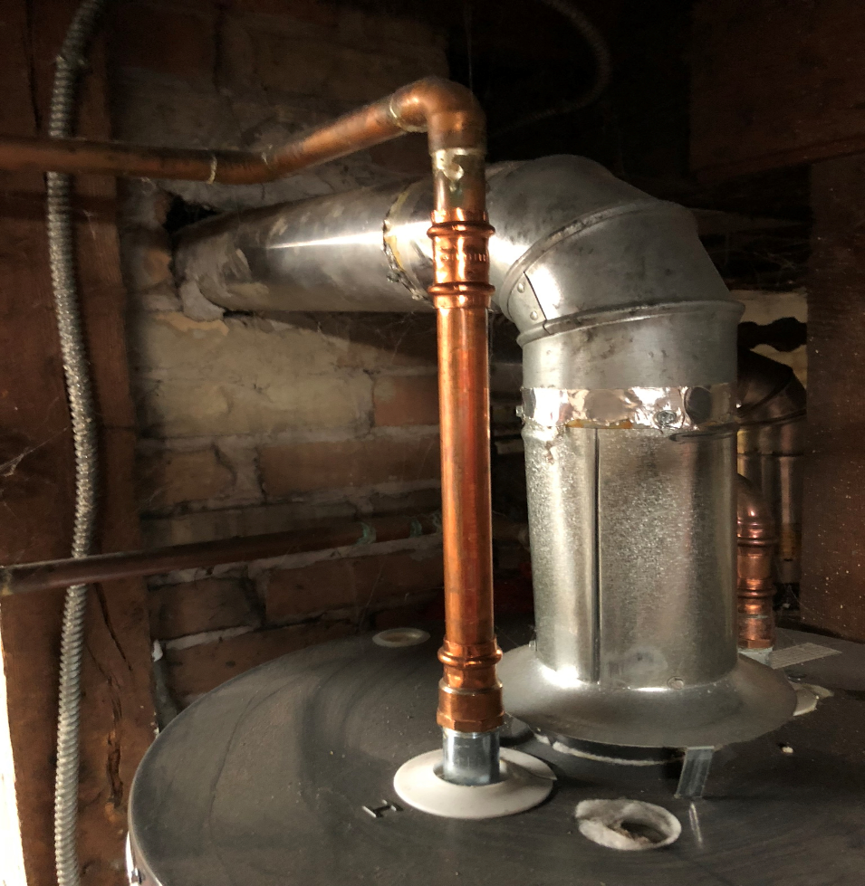
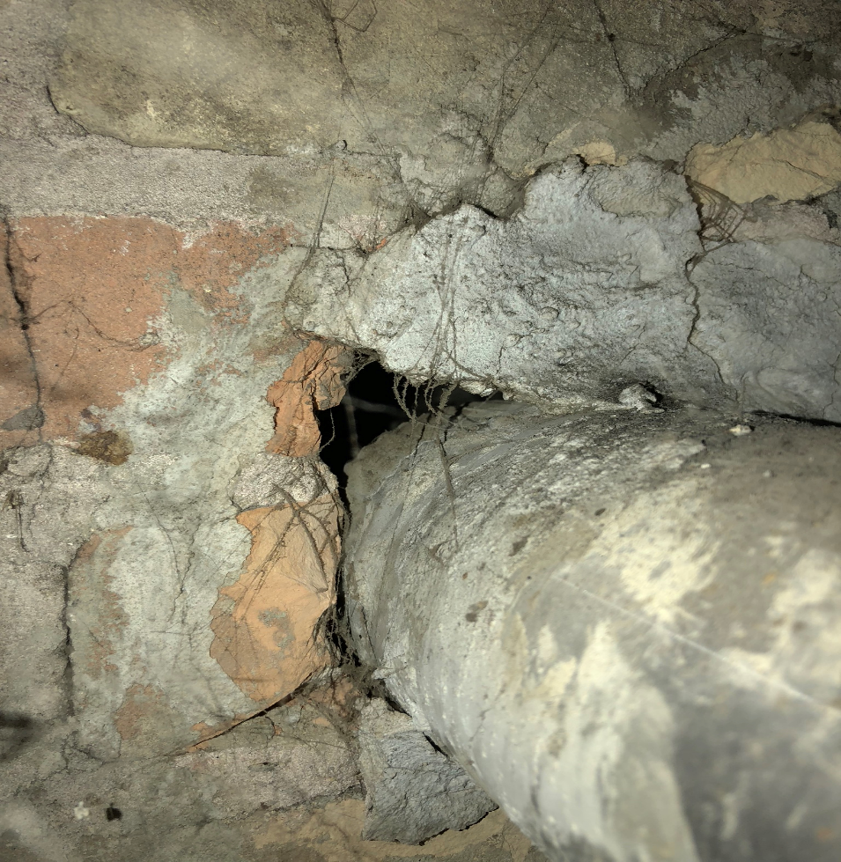
smokepipe

Slide 25
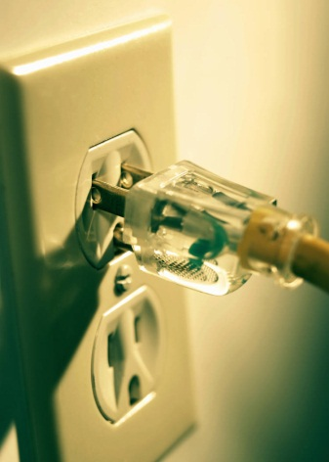
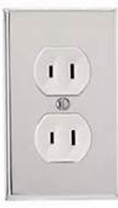
Outlets
All 3-Prong Outlets Must Be Grounded
Existing 2-Prong Outlets Permitted
Replacement of existing outlets requires ARC Fault and/or GFCI Protection based on outlet location

Slide 26
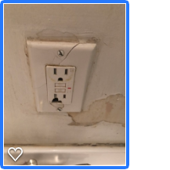
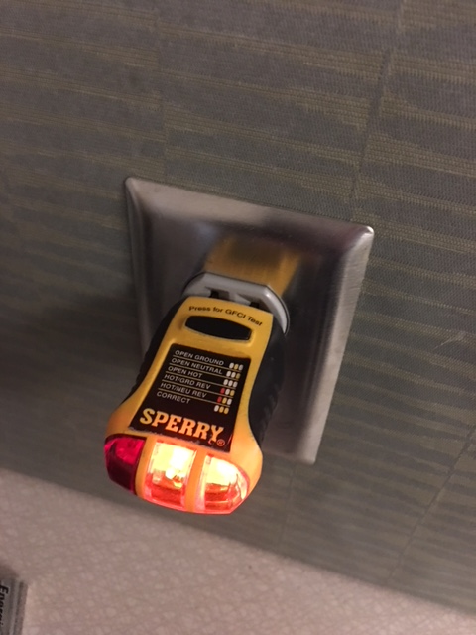
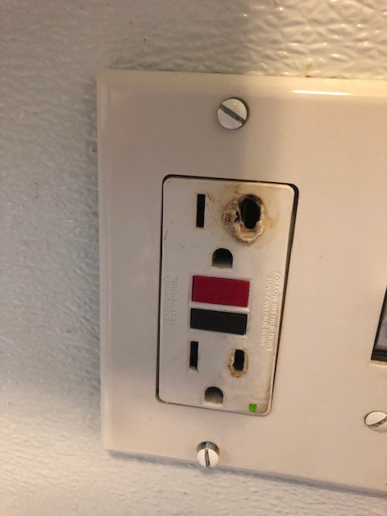
Outlets/receptacles
Check available outlets for proper grounding and damage/failure

Slide 27
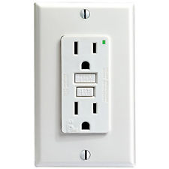
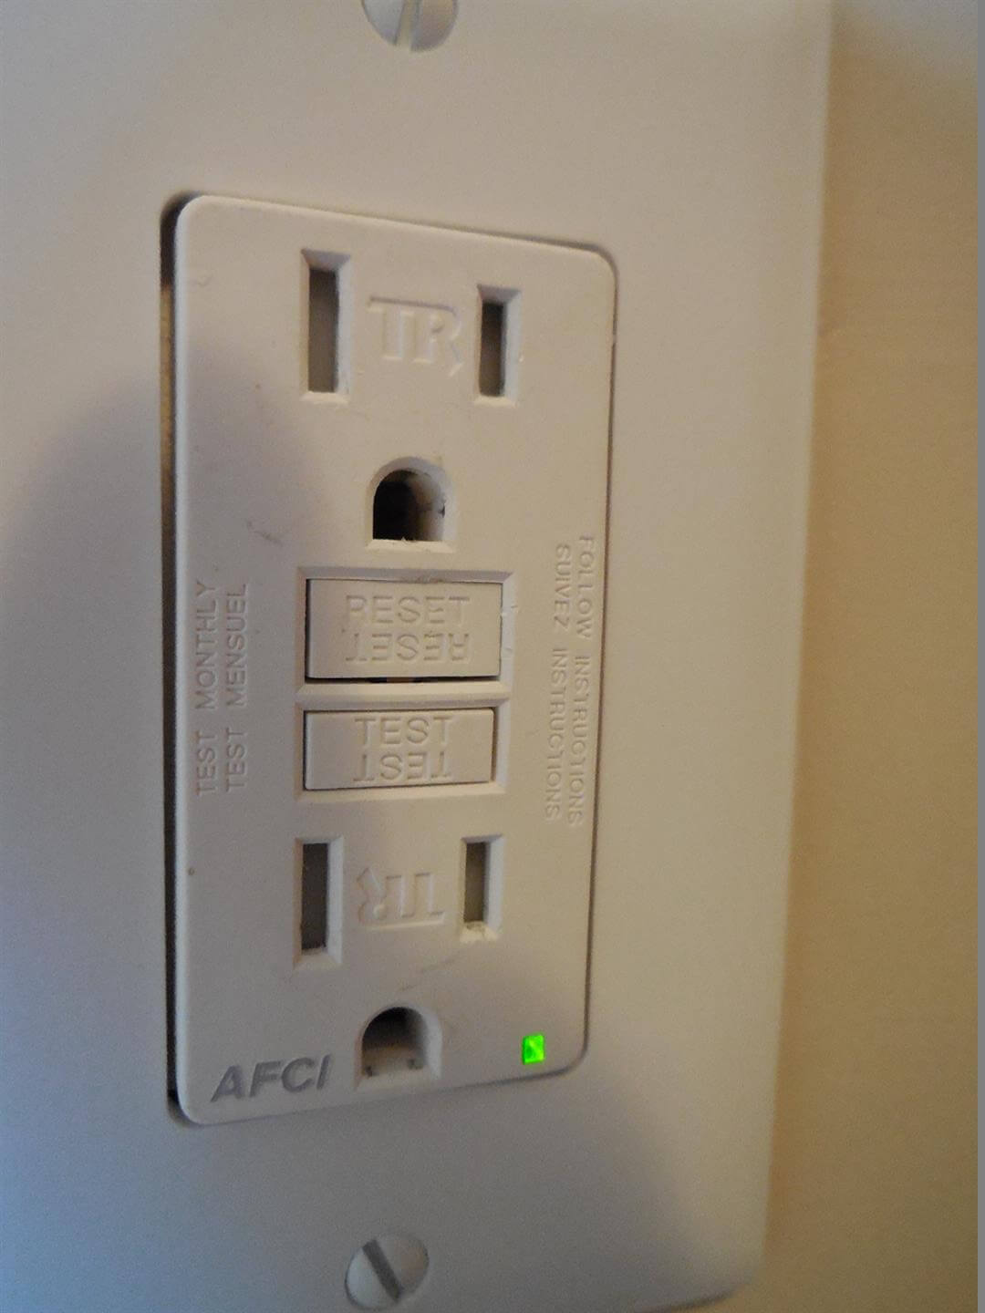
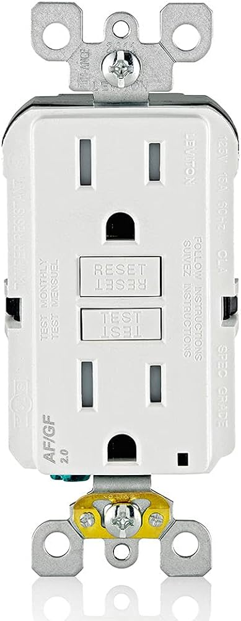
Gfci: GROUND FAULT CIRCUIT INTERUPTER
AFCI: ARC FAULT CIRCUIT INTERUPTER
GFCI
AFCI
AFCI/GFCI
This Photo by Unknown Author is licensed under CC BY-SA

Slide 28
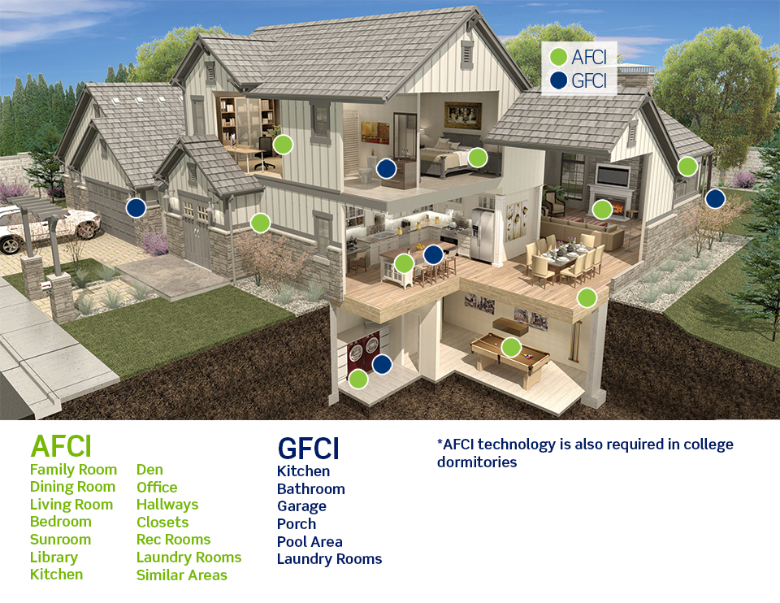
Afci and GFCI Locations

Slide 29
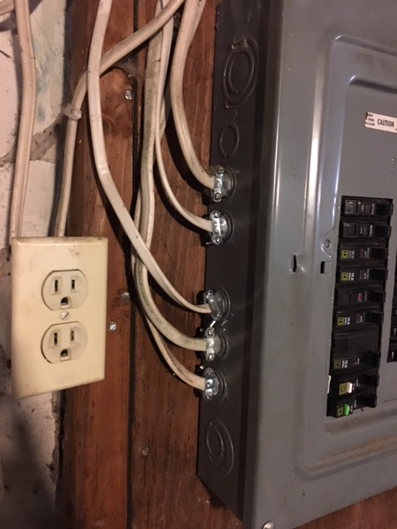
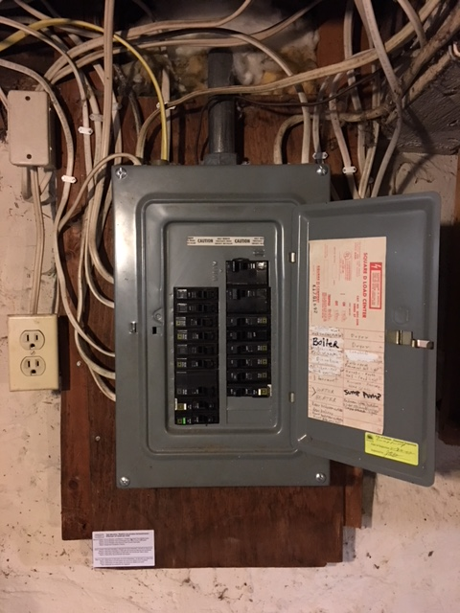
ELECTRICL SERVICE PANEL

Slide 30
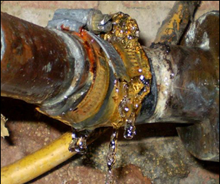
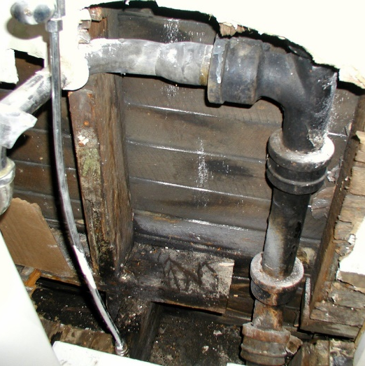

Water Supply System
505.3-The water supply system shall be installed and maintained to provide a supply of water to plumbing fixtures, devices and appurtenances in sufficient volume and at pressures adequate to enable to fixture to function properly, safely and free from defects and leaks.
Check for leaks, cracks, bad connections.
Low Water Pressure

Slide 31
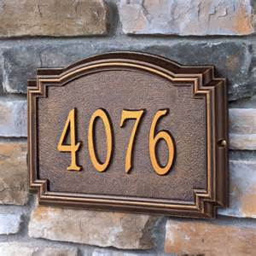
Premise Numbers
304.3 Premises identification. Buildings shall have approved address numbers placed in a position to be plainly legible and visible from the street or road fronting the property. These numbers shall contrast with their background. Address numbers shall be Arabic numerals or alphabet letters. Numbers shall be a minimum of 4 inches (102 mm) in height with a minimum stroke width of 0.5 inch (12.7 mm).

Slide 32
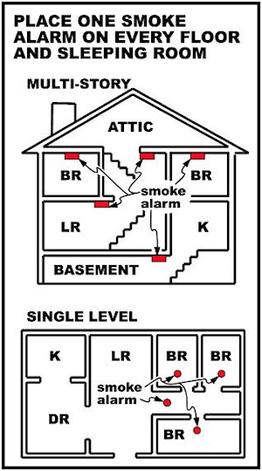
Smoke Alarm Requirement (Single Family/Duplex)
Locations
  On Each Floor
  Outside Each Bedroom
  Inside Each Bedroom

Slide 33
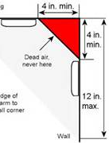
Smoke Alarm Requirement Mounting area
Mounting Area
  Wall-4” to 12” from the ceiling
  Ceiling-4” from the wall

Slide 34
Alarm Types
Photoelectric
Detect visible fire particles (associated with slow smoldering fires) sooner than ionization alarms. These detectors are more sensitive to the large combustion particles that emanate during slow, smoldering fires, which usually occur at night when people are asleep before the source of the fire bursts into flames.
Ionization
  Detect invisible fire particles (associated with fast flaming fires) sooner than photoelectric alarms such as cooking fires or fires fueled by paper or flammable liquids.

Slide 35
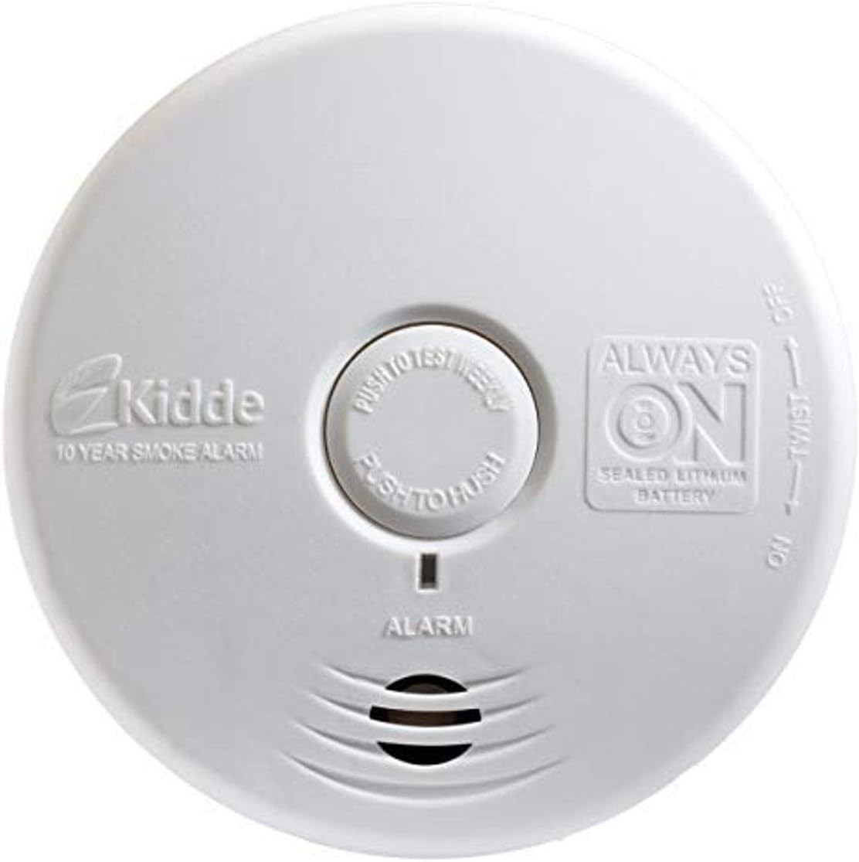
10 year smoke alarms

Slide 36
Smoke Alarm Statistics
When smoke alarms were present in fires considered large enough to activate them, they operated 87% of the time.
Three out of five home fire deaths resulted from fires in properties without alarms or non-working smoke alarms.
  Almost two out of five (38%) home fire deaths resulted from fires in which no smoke alarms were present at all.
  One of every five (21%) deaths was caused by fires in properties in which smoke alarms were present but failed to operate. (Battery Operated and Interconnected Alarms are Best)
  Smoke alarms operated in fires that caused two out of five (40%) home fire deaths.
  One percent of the deaths resulted from fires that were too small to activate the smoke alarm.

Slide 37
!!!!!!!!!!!!!!!!!!!!!!!!!!!
The risk of dying in reported home structure fires is cut in half in homes with working smoke alarms

Slide 38
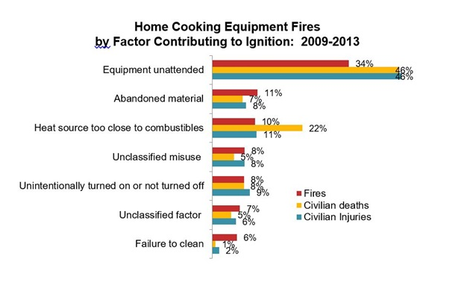
Fire Causes-Cooking

Slide 39
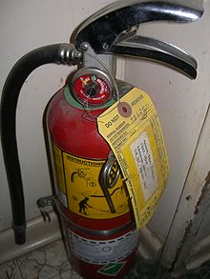
Fire Safety Requirements-Chapter 7
701.1 Scope. The provisions of this chapter shall govern he minimum conditions and standards for fire safety relating to structure and exterior premises including fire safety facilities and equipment to be provided.
Multi-Unit Buildings
  2A10BC Sized Extinguisher within 75’ of every apartment door
  OR inside each unit
Serviced/Inspected Annually
  Tagged
  Charged (Green)
  Mounted

Slide 40
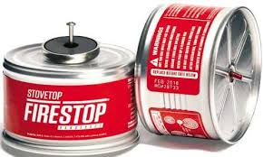
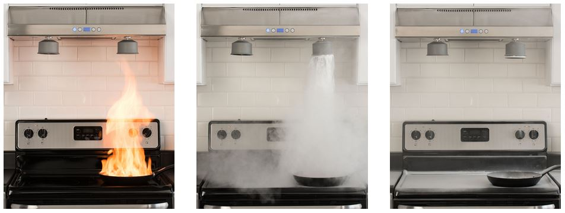
Fire Stop

Slide 41
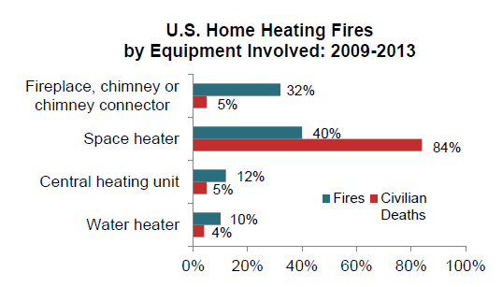
Fire Causes-Heating

Slide 42
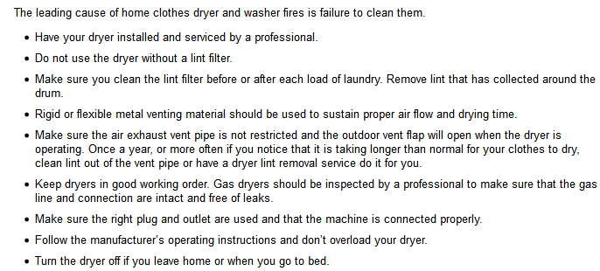
Fire Causes-Dryers

Slide 43
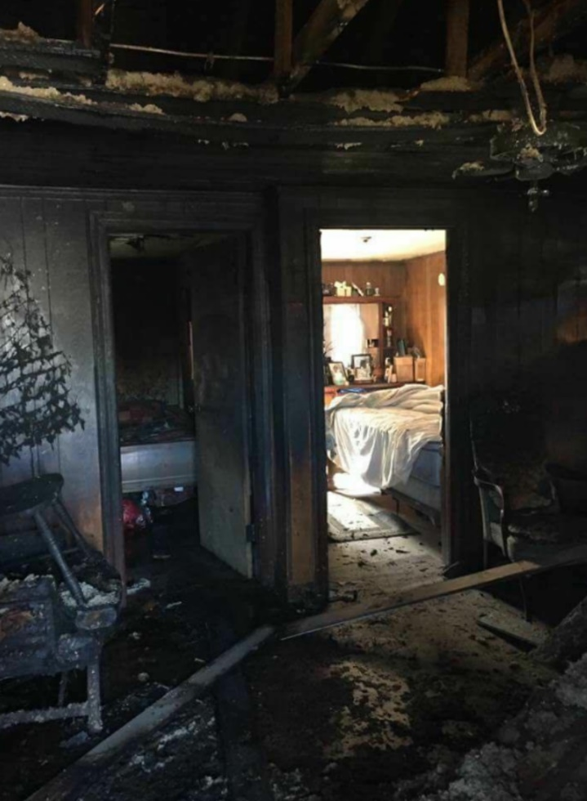
CLOSING BEDROOM DOORS
When sleeping keep bedroom doors closed
  Slows entry of fire and smoke
  Allows extra time for escape

Slide 44


Carbon Monoxide Alarms
Required within 10’ of every bedroom.
(no height requirements)

Slide 45

Heat
Maintained and functioning properly
Maintain at least 68 degrees (October 15th thru May 15th)

Slide 46

Fire Code Requirements
3’ Clearance around gas appliances
Self Closing doors between garages and habitable areas
All emergency escapes cannot be obstructed or locked.

Slide 47

Fire Code Requirements
One-Hour Fire Resistive separation between floors and units
One-Hour Fire Resistive Corridors
5/8 Type “x” Gypsum Wallboard between habitable spaces
20 Minute Fire Door Assemblies for Corridors equipped with self-closing devices

Slide 48



exterior
Rotting Shingle/Roof
Deteriorated Stairs
Missing/Deteriorated Flashing
Peeling paint

Slide 49

Tenant Complaints
Tenant must submit complaint/request to owner/landlord in writing.
No action by landlord
  Life Safety Inspection
  Correction Order
Resources
  Tenant/Landlord Rights.
  One Roof Housing Mediation
  JUSTICE NORTH (formerly Legal Aid).

Slide 50

Lack of compliance
Fees
Citations
  Criminal
      Civil/Monetary
Revocation
Condemnation
This Photo by Unknown Author is licensed under CC BY

Slide 51
Questions

